Slide 1

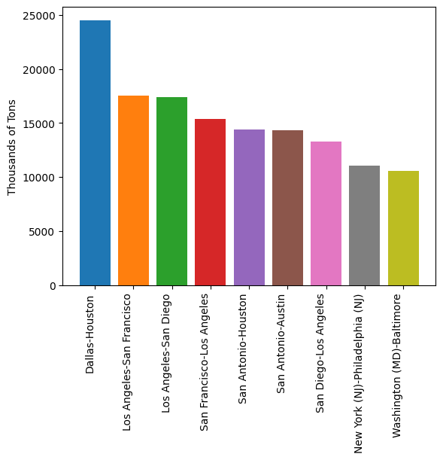
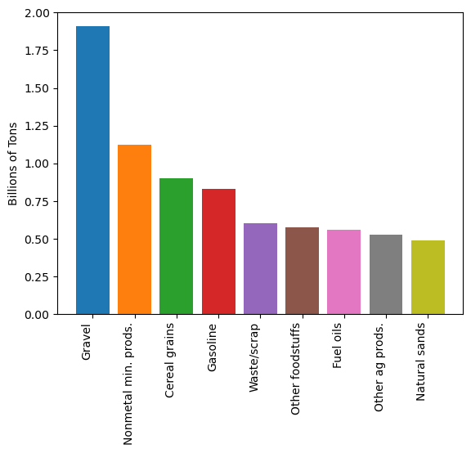
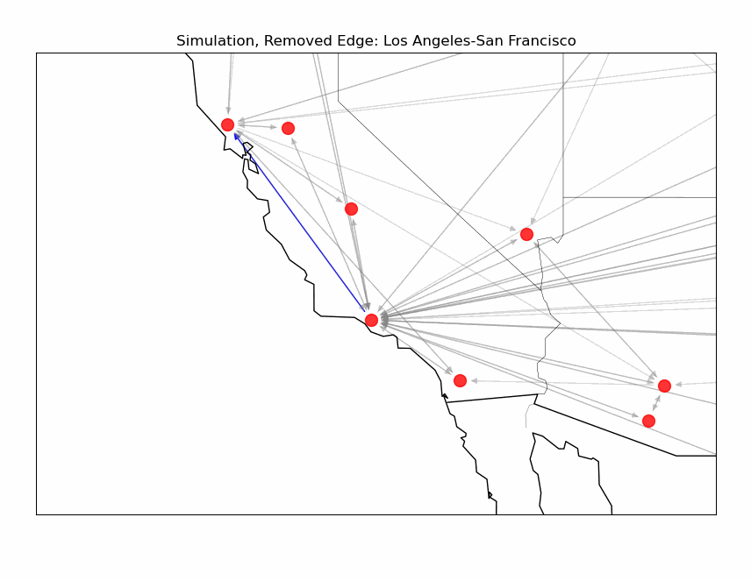
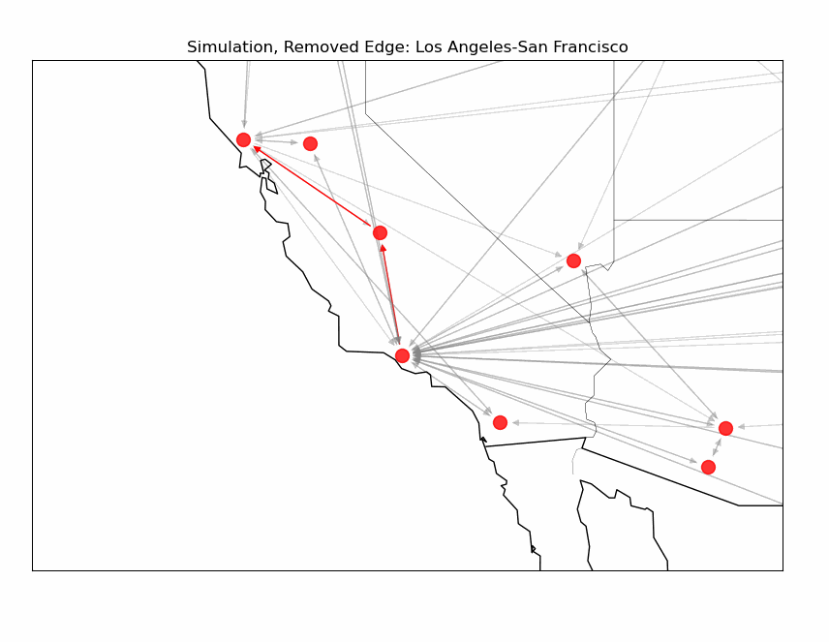
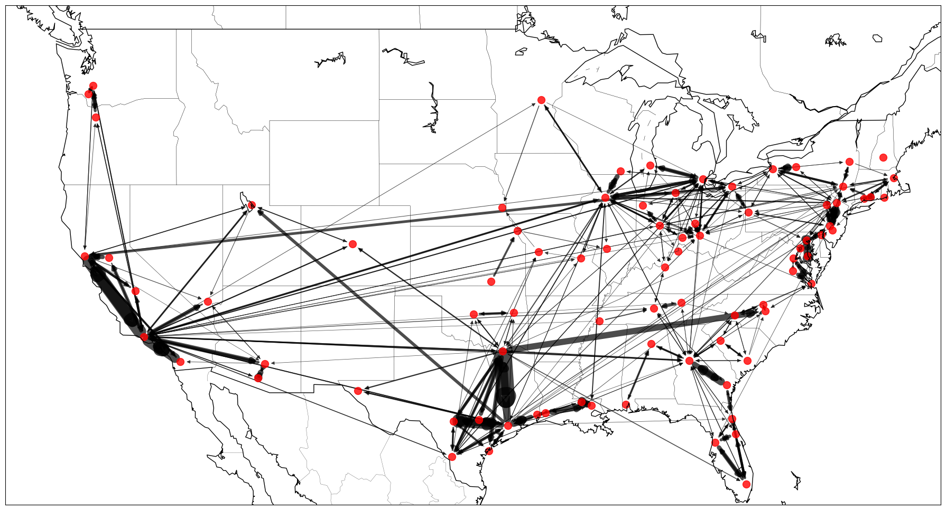
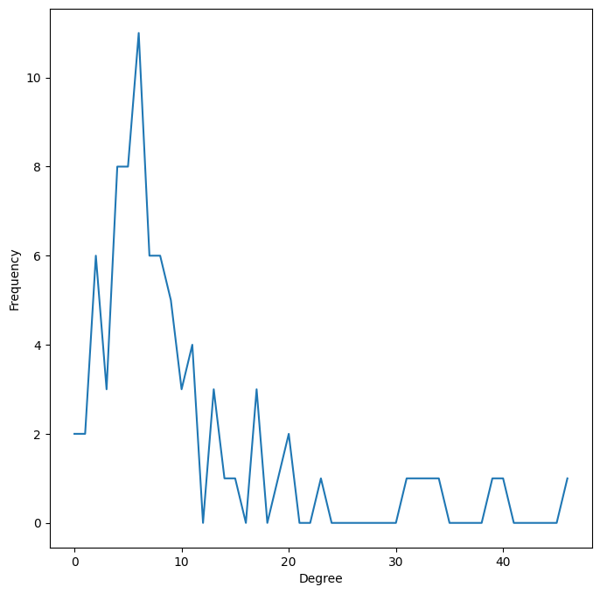
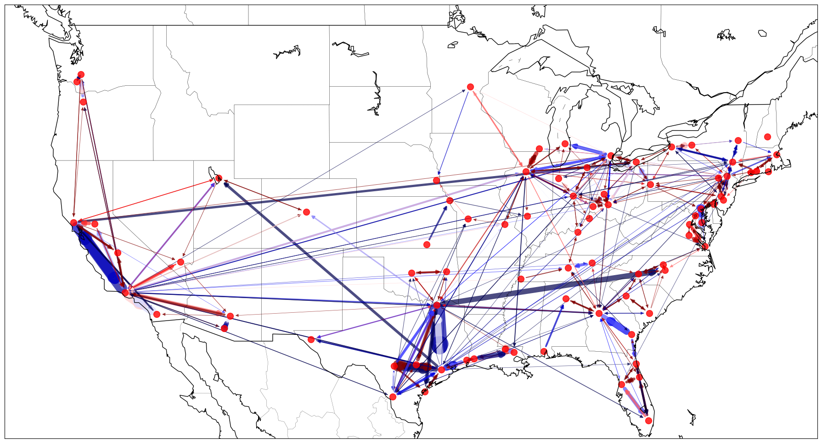
Simulating Disruption Events in the US Highway Freight Network
Ananya Bishnoi, Frank Tucci, Luke Franks, Miya Reese
Advised by Dr. Theresa Migler
Overview
The most highway freight density is found in the California, Texas Triangle, Midwest, and East Coast regions. The most connected nodes, measured using closeness centrality, are often central to these areas.
Edge | Average Increase in Thousand Tons
Dallas-Houston | 24511
Los Angeles-San Francisco | 17562
Los Angeles-San Diego | 17430
San Francisco-Los Angeles | 15352
San Antonio-Houston | 14372
The US Department of Transportation releases a yearly report of aggregate US freight data as part of the Freight Analysis Framework (FAF). This contains data of the origin and destination of shipments, mode of transportation, and estimated weight and value. 11.7 billion tons of cargo, worth roughly $15 trillion dollars was shipped on domestic, point-to-point trips on US highways in 2022.
Simulation Design
To simulate a disruption event that blocks travel between two city pairs, we remove an arbitrary edge from the graph. The next-shortest route is then calculated, and the cargo is re-routed through at least one intermediate node on the way to its destination. This increased load can be stored as an edge attribute and used to calculate an increase as a percentage to the edge’s normal throughput to identify which highways may be more vulnerable to an increase in traffic when a nearby edge fails.
Edge | Proportion of Starting Value
Corpus Christi-Austin | 1.11
Washington (DC)-Baltimore | 1.08
Richmond-Washington (DC) | 1.06
Fresno-Sacramento | 1.05
Austin-Corpus Christi | 1.05
Figure 1: Top 10 city pairings and commodity types
The city pairs most vulnerable are the small to medium-sized cities that run parallel to already large highway trade corridors. Cataloguing this information is likely of interest to transportation planners and emergency response crews who rely upon similar models to plan for and be able to take advanced action in the result of a highway disruption.
Network Construction
The network was modeled using the FAF’s statistical metro areas as nodes and tons of cargo transported between the the origin and destination nodes as directed edges. Edge weights represent tons of cargo. We looked only at trade corridors with greater than 500,000 tons of cargo shipped in the continental US only.
Figure 3: A path from Los Angeles to San Francisco (Blue) is rerouted through Fresno (Red) after a disruption event
Future Work
This simulation can be repeated so that each edge in the graph is removed exactly once, and the increased load factor averaged by the number of simulations to determine how vulnerable a road is to strain resulting from a disruption event.
Next steps in this project would involve taking a more in-depth look at the US highway system to construct a more realistic model of the US Interstate system, rather than a point-to-point based network simulation as done here. Additionally, we could look at a more realistic route-assignment algorithm that can split a shipment over multiple paths, or across multiple modalities of transportation (like rail).
Findings
References
Figure 2: Map of the constructed network and degree distribution
Bureau of Transportation Statistics. Freight Analysis Framework 5. Available online: https://www.bts.gov/faf
Metro Area | Closeness Centrality
Atlanta | 0.50
Los Angeles | 0.49
Detroit | 0.48
Chicago (IL) | 0.47
Dallas | 0.46
Figure 4: Color overlay with edges in red being found to be the most vulnerable to congestion, and blue being the least.

